Slide 1
Missing Value and Normalization
Gautham M
15Co118

Slide 2
Data Preprocessing
Data preprocessing is a data mining technique that involves transforming raw data into an understandable format. Real-world data is often incomplete, inconsistent, and/or lacking in certain behaviors or trends, and is likely to contain many errors

Slide 3
Handling Missing values
Why??
In surveys people generally tend to leave the field of income blank or sometimes people have no information available and cannot answer the question. Also in the process of collecting data from multiple sources some data may be inadvertently lost.
Example in a Form If there are two fields marital status and no of children. Then if the marital status is Unmarried then no of children field may be empty.
Machine Might be faulty the System went down for a particular period of time

Slide 4
Deleting
Here, we either delete a particular row if it has a null value for a particular feature and a particular column if it has more than 70-75% of missing values.This method is advised only when there are enough samples in the data set.
Pros:
Complete removal of data with missing values results in robust and highly accurate model
Deleting a particular row or a column with no specific information is better, since it does not have a high weightage
Cons:
Loss of information and data
Works poorly if the percentage of missing values is high (say 30%), compared to the whole dataset

Slide 5
Replacing With Mean/Median/Mode
This strategy can be applied on a feature which has numeric data like the age of a person or the ticket fare. We can calculate the mean, median or mode of the feature and replace it with the missing values. This is an approximation which can add variance to the data set.
Pros:
This is a better approach when the data size is small
It can prevent data loss which results in removal of the rows and columns
Cons:
Imputing the approximations add variance and bias
Works poorly compared to other multiple-imputations method

Slide 6
Assigning An Unique Value
A categorical feature will have a definite number of possibilities, such as gender, for example. Since they have a definite number of classes, we can assign another class for the missing values.
Pros:
Less possibilities with one extra category, resulting in low variance after one hot encoding — since it is categorical
Negates the loss of data by adding an unique category
Cons:
Adds less variance
Adds another feature to the model while encoding, which may result in poor performance

Slide 7
Predicting The Missing Values
Using the features which do not have missing values, we can predict the nulls with the help of a machine learning algorithm Like Regression.
Pros:
Imputing the missing variable is an improvement as long as the bias from the same is smaller than the omitted variable bias
Yields unbiased estimates of the model parameters
Cons:
Bias also arises when an incomplete conditioning set is used for a categorical variable
Considered only as a proxy for the true values

Slide 8
Normalization
The goal of standardization or normalization is to make an entire set of values have a particular property.
We have to normalize our data because our features do not have a uniform scale.

Slide 9
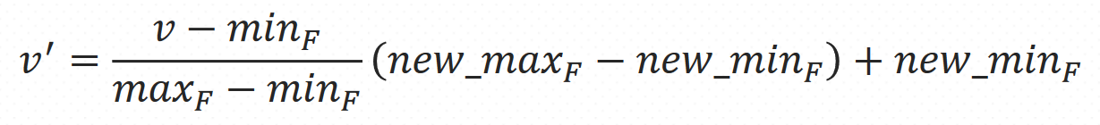
Min Max Normalization
In this approach, the data is scaled to a fixed range - usually 0 to 1.
Transform the data from measured units to a new interval
Where v is the current value of feature

Slide 10
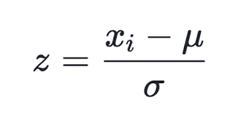
Z Score Normalization
Transform the data by converting the values to a common scale with an average of zero and a standard deviation of one.

Slide 11
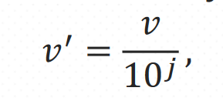
Decimal Scale
Transform the data by moving the decimal points of values of feature F . The number of decimal points moved depends on the maximum absolute value of F
Where j is the smallest integer such that Max(|ν’|) < 1

Slide 12
Thank You

